Slide 1
6.6: Solving Trigonometric Equations
MATH 1550 - Precalculus

Slide 2
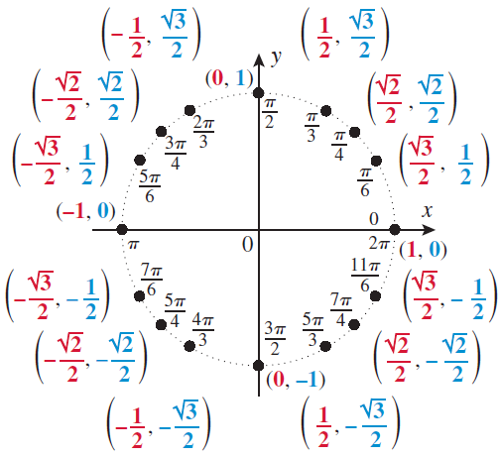



Ex: Solve $\cos\left(θ\right)=\frac{1}{2}$ over $[0,2π)$
Recall that in general on the unit circle, $\cos{θ}=x$
Thus, we look at the x-coordinate: cosine of which angles equals $\frac{1}{2}$?
$θ=\frac{π}{3},\frac{5π}{3}$.

Slide 3



Ex: Solve $\sin\left(θ\right)=−\frac{\sqrt{3}}{2}$ over $[0,2π)$
Recall that in general on the unit circle, $\sin{θ}=y$
Thus, we look at the $y$-coordinate: sine of which angles equals $−\frac{\sqrt{3}}{2}$?
$θ=\frac{4π}{3},\frac{5π}{3}$.

Slide 4
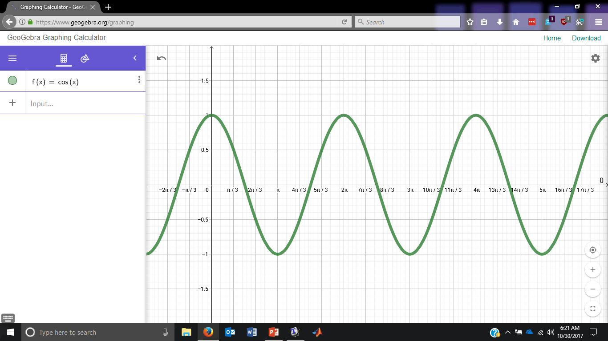



Ex: Solve $\cos\left(θ\right)=\frac{1}{2}$
$$2π$$
Notice how there’s no statement of where the solution is to be found.
If there is no statement of domain, assume you solve the equation over all real numbers.
$$2π$$

Slide 5
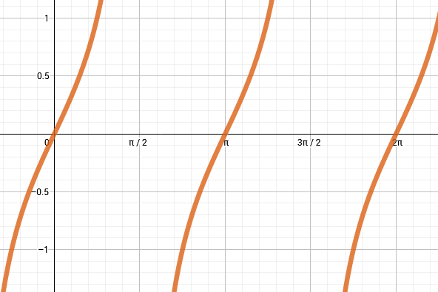


Ex: Solve $\tan\left(θ\right)=−1$.
Decide where $\tan\left(θ\right)=−1$ over $[0, 2π)$.
π

Slide 6


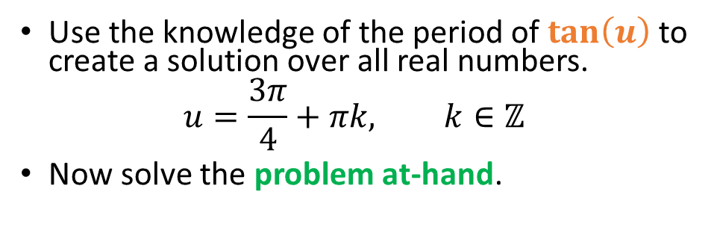
Ex: Solve $\tan\left(3θ\right)=−1$.
First, decide where simply $\tan\left(u\right)=−1$ over $[0, 2π)$.
Use the knowledge of the period of $\tan\left(u\right)$ to create a solution over all real numbers.
$$u=\frac{3π}{4}+πk, k∈ℤ$$
Now solve the problem at-hand.
π

